Slide 1
BRONCHIAL ASTHMA
A
HOMOEOPATHIC PERSPECTIVE
PRESENTED BY
DR.T.AJAYAN
HOD.OF PRACTICE OF MEDICINE
SKHMC,KULASEKHARAM

Slide 2
STATISTICAL ANALYSIS
 | 1 | 2 | 3 | 4 | 5 | 6 | 7 | 8 | 9 | 10 | 11 | 12 | 13 | 14
1
2
3
4
5
6
7
8
9
10
11
12
13
14

Slide 3
Questionnaire
1. In which age group you get maximum number of Bronchial asthma cases?
1 – 10 yrs . girls/women
11 – 20 yrs . boys/men
21- 30 yrs
31 – 40 yrs
41 – 50 yrs
51 – 60 yrs
61 - 70 yrs

Slide 4
2. Whether Bronchial asthma is prevalent in your locality? If so any proposed reasons and whether it is helping you in selecting the similimum?
If yes, please specify……….

Slide 5
3. In which phase do you get maximum cases of Bronchial asthma?
During attack
Without attack

Slide 6
4. What type of management you are giving during acute phase?
  Nebulisation
  Tinctures
  Potency
  Depending on severity of the case
If potency specify,
  Low
  medium
  High
  LM potency

Slide 7
5. If depending upon the case, can you give some suggestions?
----------------------------------------------------------------------------------------------------------------------------------------------------------------------------------------------------------------------------------------------------------------------------------------------------------------------------------------------------------------------------------------------------------------------------------------------------------------------------

Slide 8
6. Type of management in chronic asthmatic cases ?
  Symptomatically
  Specific
  Constitutional
Any other --------------------------------------------------------------------------------------------------------------

Slide 9
7. What potency do you prefer during chronic phase of bronchial asthma?
  Low
  Medium
  High
  LM potency

Slide 10
8. Can you mention some cases which you feel different from other cases of bronchial asthma which you have treated? (With characteristic indications of medicines, if any)
--------------------------------------------------------------------------------------------------------------------------------------------------------------------------------------------------------------------------------------------------------------------------------------------------------------------------------------------------------------

Slide 11
9. What is the frequency of repetition of medicines in acute phase? Do you follow any parameter for that? If yes, could you suggest? (Please mention your experience) -----------------------------------------------------------------------------------------------------------------------------------------------------------------------------------------------------------------------------------------------------------------------------------------------------------------------------------------------------------------------------------------------

Slide 12
10. In your long career of treating bronchial asthma cases, what is the scope of homoeopathic medicines? (If you have any statistics, please attach) -------------------------------------------------------------------------------------------------------------------------------------------------------------------------------------------------------------------------------------------------------------------------------------------------------------------------------------------------------------------------------------------------------------------

Slide 13
11. Do you use any modern investigative procedure (eg: Spirometer) in assessing the severity / prognosis of asthma? -------------------------------------------------------------------------------------------------------------------------------------------------------------------------------------------------------------

Slide 14
12. Do you advice any special dietary pattern during the treatment of bronchial asthma?
------------------------------------------------------------------------------------------------------------------------------------------------------------------------------------------------------------------------------------------

Slide 15
13. Probable duration taken for the treatment in acute asthmatic conditions?
-------------------------------------------------------------------------------------------------------------------

Slide 16
14. Have you treated any status asthmaticus case? Please share your experience? ------------------------------------------------------------------------------------------------------------------------------------------------------------------------------------------------------------------------------------------------------------

Slide 17
15. Do you adopt any special case taking procedure of your own? If yes, please share with us?
--------------------------------------------------------------------------------------------------------------------------------------------------------------------------------------------------------------------------------------------------------------------------------------------------------------------------------------------------------------

Slide 18
16. Which repertory you like most for working bronchial asthma cases? If any one, please mention and why? -----------------------------------------------------------------------------------------------------------------------------------------------------------------------------------------------------------------

Slide 19
17. Your experiences in treating asthma alternating with skin / rheumatic/ GIT complaints? ------------------------------------------------------------------------------------------------------------------------------------------------------------------------------------------------------------------------------------------------------------------------------------------------------------------------------------------------------------

Slide 20
18. Have you come across cases in which during the treatment of bronchial asthma skin complaints appear after disappearance of respiratory trouble, how will you manage it?
(Is wait and watch method ideal?) -----------------------------------------------------------------------------------------------------------------------------------------------------------------------------------------------

Slide 21
19. Will you please suggest some specific medicines useful in controlling acute exacerbations?
--------------------------------------------------------------------------------------------------------------------------------------------------------------------------------------------------------------------------------------------------------------------------------------------------------------------------------------------------------------
20. Any other suggestion

Slide 22
Case 1
Name :Mrs. Sarojini bhai
Age/sex :61/F,
OP No. 721/8
Date:12/05/2008
DISEASE DIAGNOSIS :BRONCHIAL ASTHMA WITH BILATERAL LOWER LOBE CYLINDRICAL BRONCHIETASIS

Slide 23
Came with fever, cough and breathing difficulty.
She had been taking medicines for the same complaints of repeated episodes since 17/01/2008.
Fever associated with body pain, chilliness and headache. Cough with scanty expectoration.
Thirst : Decreased Tongue. Dry coated white, < evening, Restless
on this basis, She was given PULSATILLA 200/1d in 10 ml aqua 10 gtt 3 hrly, PLACEBO and was asked to report to the OP with PFT, HRCT Reports

Slide 24
Blood Report on 12/05/2008
Hb - 103. g/dl
TWBc - 9,800 cells
N - 62 %
L - 29 %
E - 9%
ESR - 50 mm (1/2 hr) 95 mm (1 hr)
Serum Cholestrol - 152 mg/dl
HDL - 150 mg/dl
Temp - 101.8º F

Slide 25
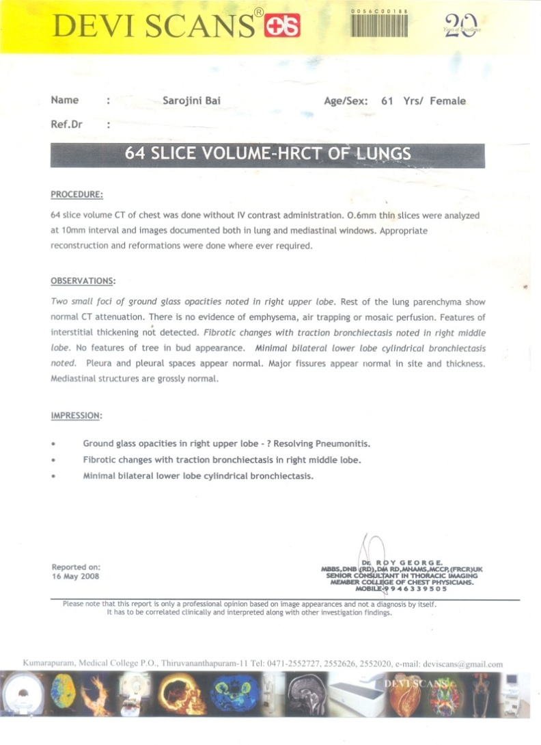

Slide 26
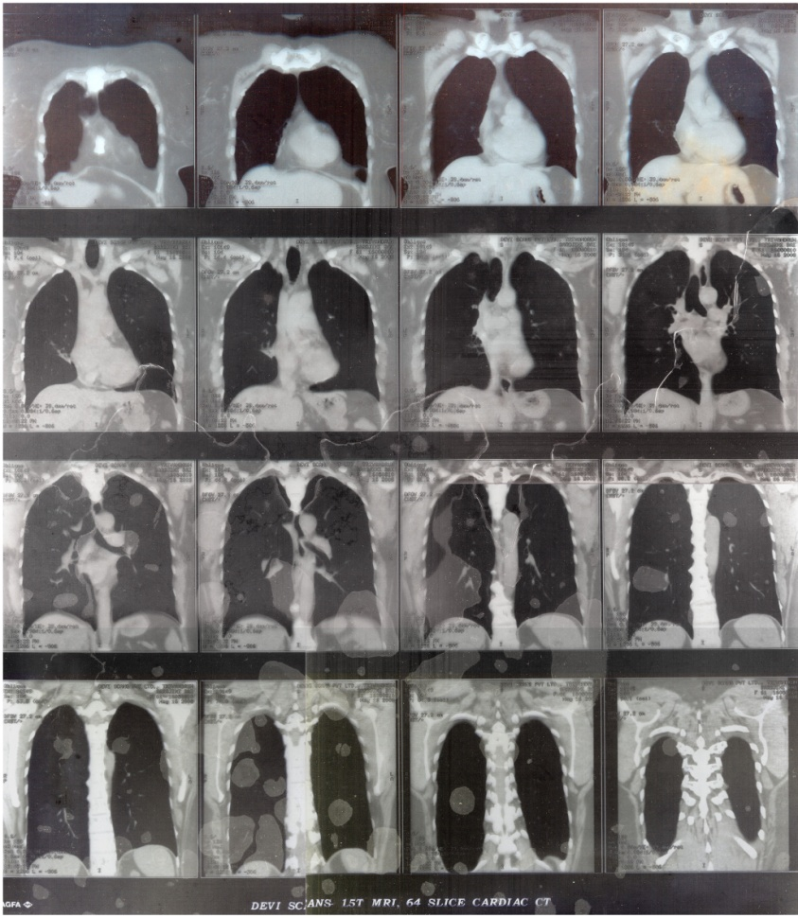

Slide 27
PFT (16/05/2008)
Diagnosis : Obstructive abnormality
Moderately severe
Restrictive abnormality Severe

Slide 28
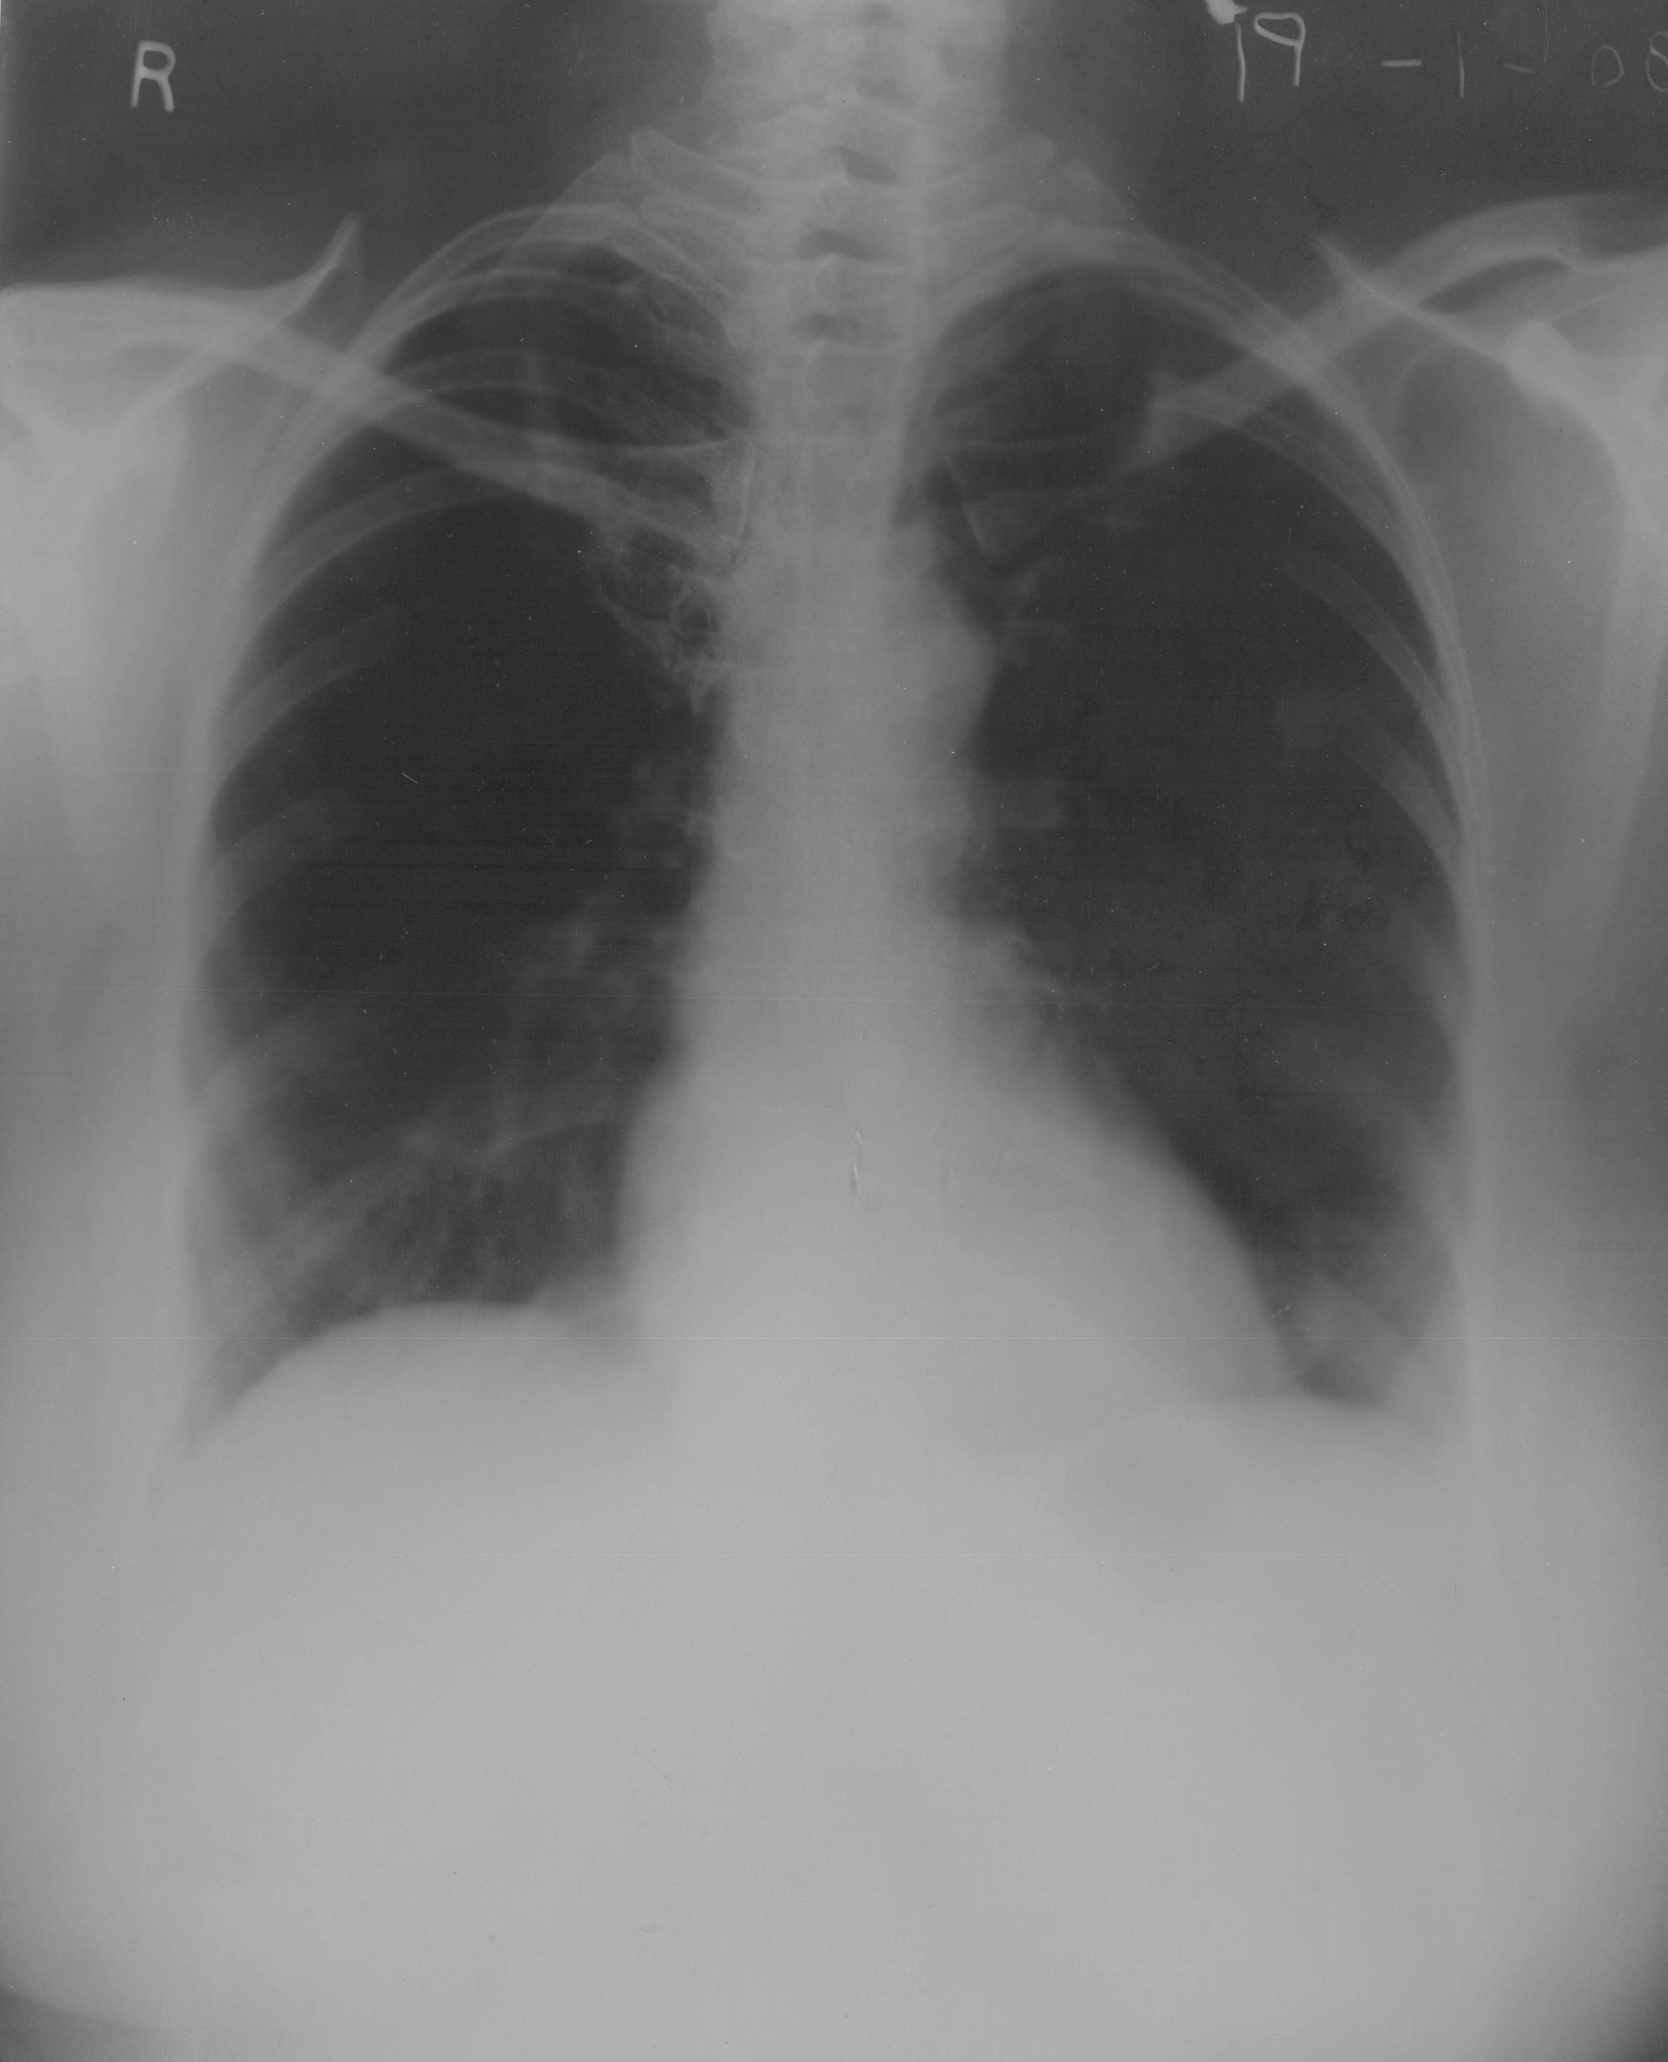

Slide 29
On this visit she had no fever, cough reduced, breathing difficulty reduced, Normal thirst, Lungs clean Puls 200/1 dose 10gtt Qid, Placebo. On the subsequent visit cough and breathing difficulty got better.
On 10/06/2008 PULS 200/ 1 dose in 10 ml aqua 10 gtt 3 hrly for fever. Cough and headache. Placebo till 01/07/2008. He presented with cough, coryza after exposure from cold damp air. NATRUM SULPH 200/1dose on 08/07/2008. Cough, fever, breathing difficulting for the last 3 days. Cough < evening, chilliness Puls 200/1 dose. in 10ml/ 10 gtt 3 hrly. ESR 25mm, RBS 122 mg/d. On her next visit cough and breathing difficulty reduced, thirst normal, Rx PLACEBO.

Slide 30
On 22/7/2008 no cough, breathing difficulty, lungs clear. She had developed eczematous eruption on her right palm, felt with great itching. PLACEBO given.
On 05/08/2008 no cough, breathing difficulty skin eruption scaly eruption on dorsum of left foot, left knee and right palm. Itching < night ,scratches till the skin peels off. Burning while scratching oozing of sticky discharge from eruption,. generals: good. No cough, breathing difficulty BP : 118/70 mm Hg, ESR 22mm/hr, RBS 182 mg/dl.
Rx PLACEBO.

Slide 31
On 24/09/2008 skin eruption had spread and the patient came to the IP for admission with PLACEBO. On 14/10/2008 right sided chest pain for the last 2 days. L Cold weather external heat sensations feverish feeling, headache, skin complaints a little better, but persist PLACEBO.
On 24/09/2008 skin eruption had spread and the patient came to the IP for admission with PLACEBO

Slide 32
On 21/10/2008 chest pain, heat sensation a little better but persist. Skin complaints remains same Rx GRAPH 0/3/1 dose, Placebo. Placebo was continued till 6/11/2008. Fever with chilliness body pain, dryness of lips, restlessness. Tongue.;dry , APP; decreased,
Thirst;decreased. Rx Gels 200/1 dose in 10 ml 10 gtt 3 hrly Placebo.

Slide 33
13/11/2008 fever with chilliness body pain, dryness of lips, Oozing of blood and pus from eruption.. Dark discolouration of the left ankle and the lateral side of right hand for the last 7 days. Itching ,<, App. decreased, thirst; increased. Rx Ars alb 200/ld, Placebo. Admitted in I.P.
Patient had fever till 17/11/2008, no other medicine was given.

Slide 34
On 22/12/08 as itching of foot had increased ARSALB 200 / 1 dose (next morning). Placebo was given till 26/12/08.
On 27/12/08 as burning had aggravated the previous night. Ars alb 200/1 dose in 10 ml aqua 10gtt. The skin complaints gradually became better and she was discharged on 22/12/08.

Slide 35
On 30/12/08 she reported to the OP with cough, breathing difficulty, Rhonchi (mild), (Right upper lobe) ESR 55 mm/hr;. RBS 135 mg/dl, Rx Sulph 200/ 1 dose, Placebo
On 05/01/09 Sulph 1m/1d.
On13/01/09 oozing continuing Nihilenim
Report 64 slice volume HRCT of LUNG
Impression :No obvious abnormality of lungs detected on HRCT examination
Rx Placebo given.

Slide 36
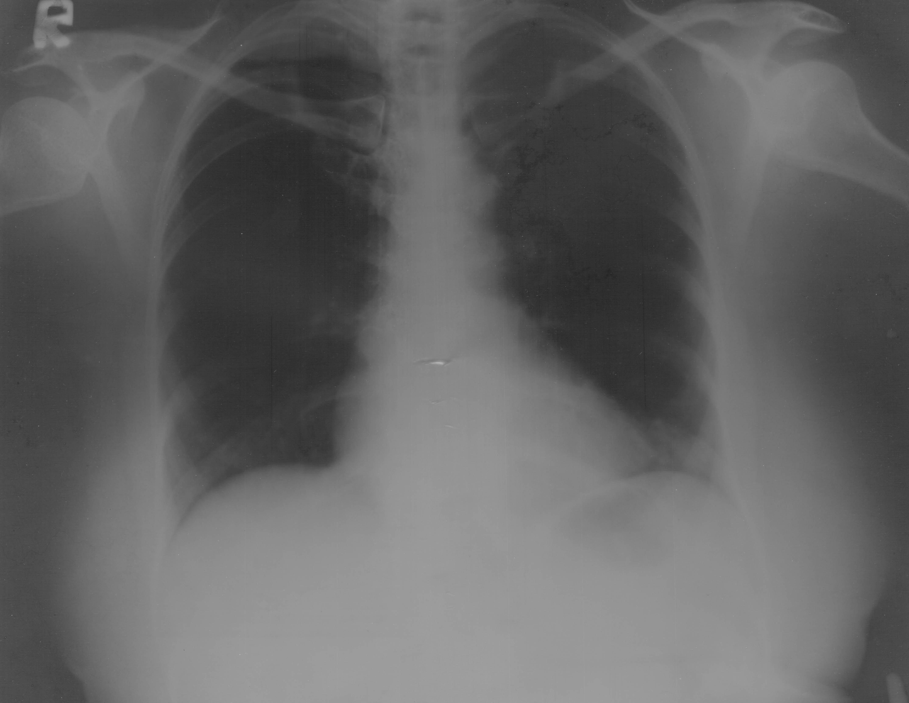

Slide 37
Her skin complaints gradually became better and she was given a dose of PSORINUM 200.

Slide 38
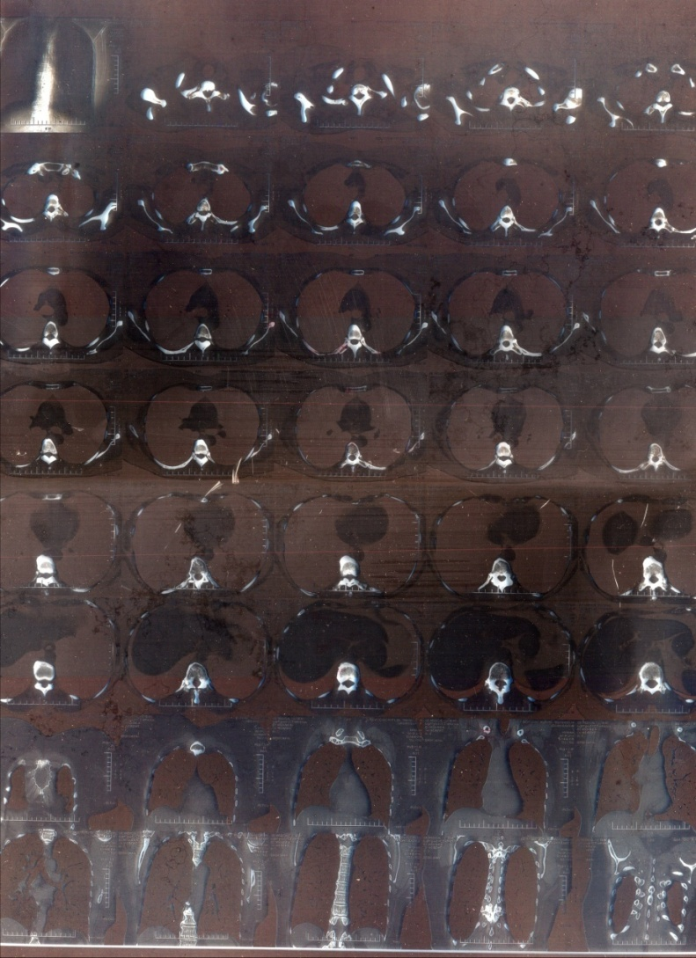

Slide 39
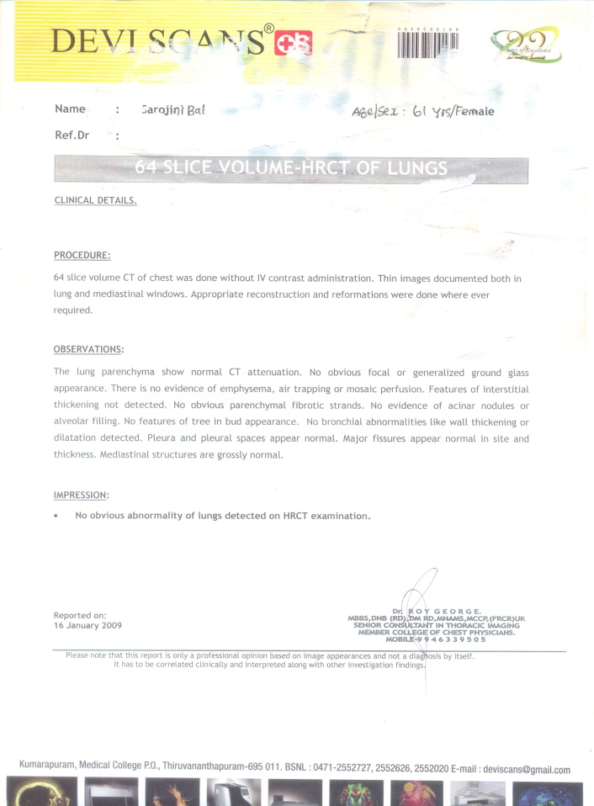

Slide 40
Case - II
OP No : 2658/09‘
Name : Master Bgoutham siva surya
Age : 1 1/2 years
Sex : M/L
Address : Attoor
A 11/2 years male child B came to our OP on 21.03.09' with cough, fever and reddish eruption, loose stool : 1 day. Other generals good. He was admitted in our IP and was prescribed Rx ANTITART 200/1 dose cu loml 10 gtt hrly 2 times, PLACEBO.

Slide 41
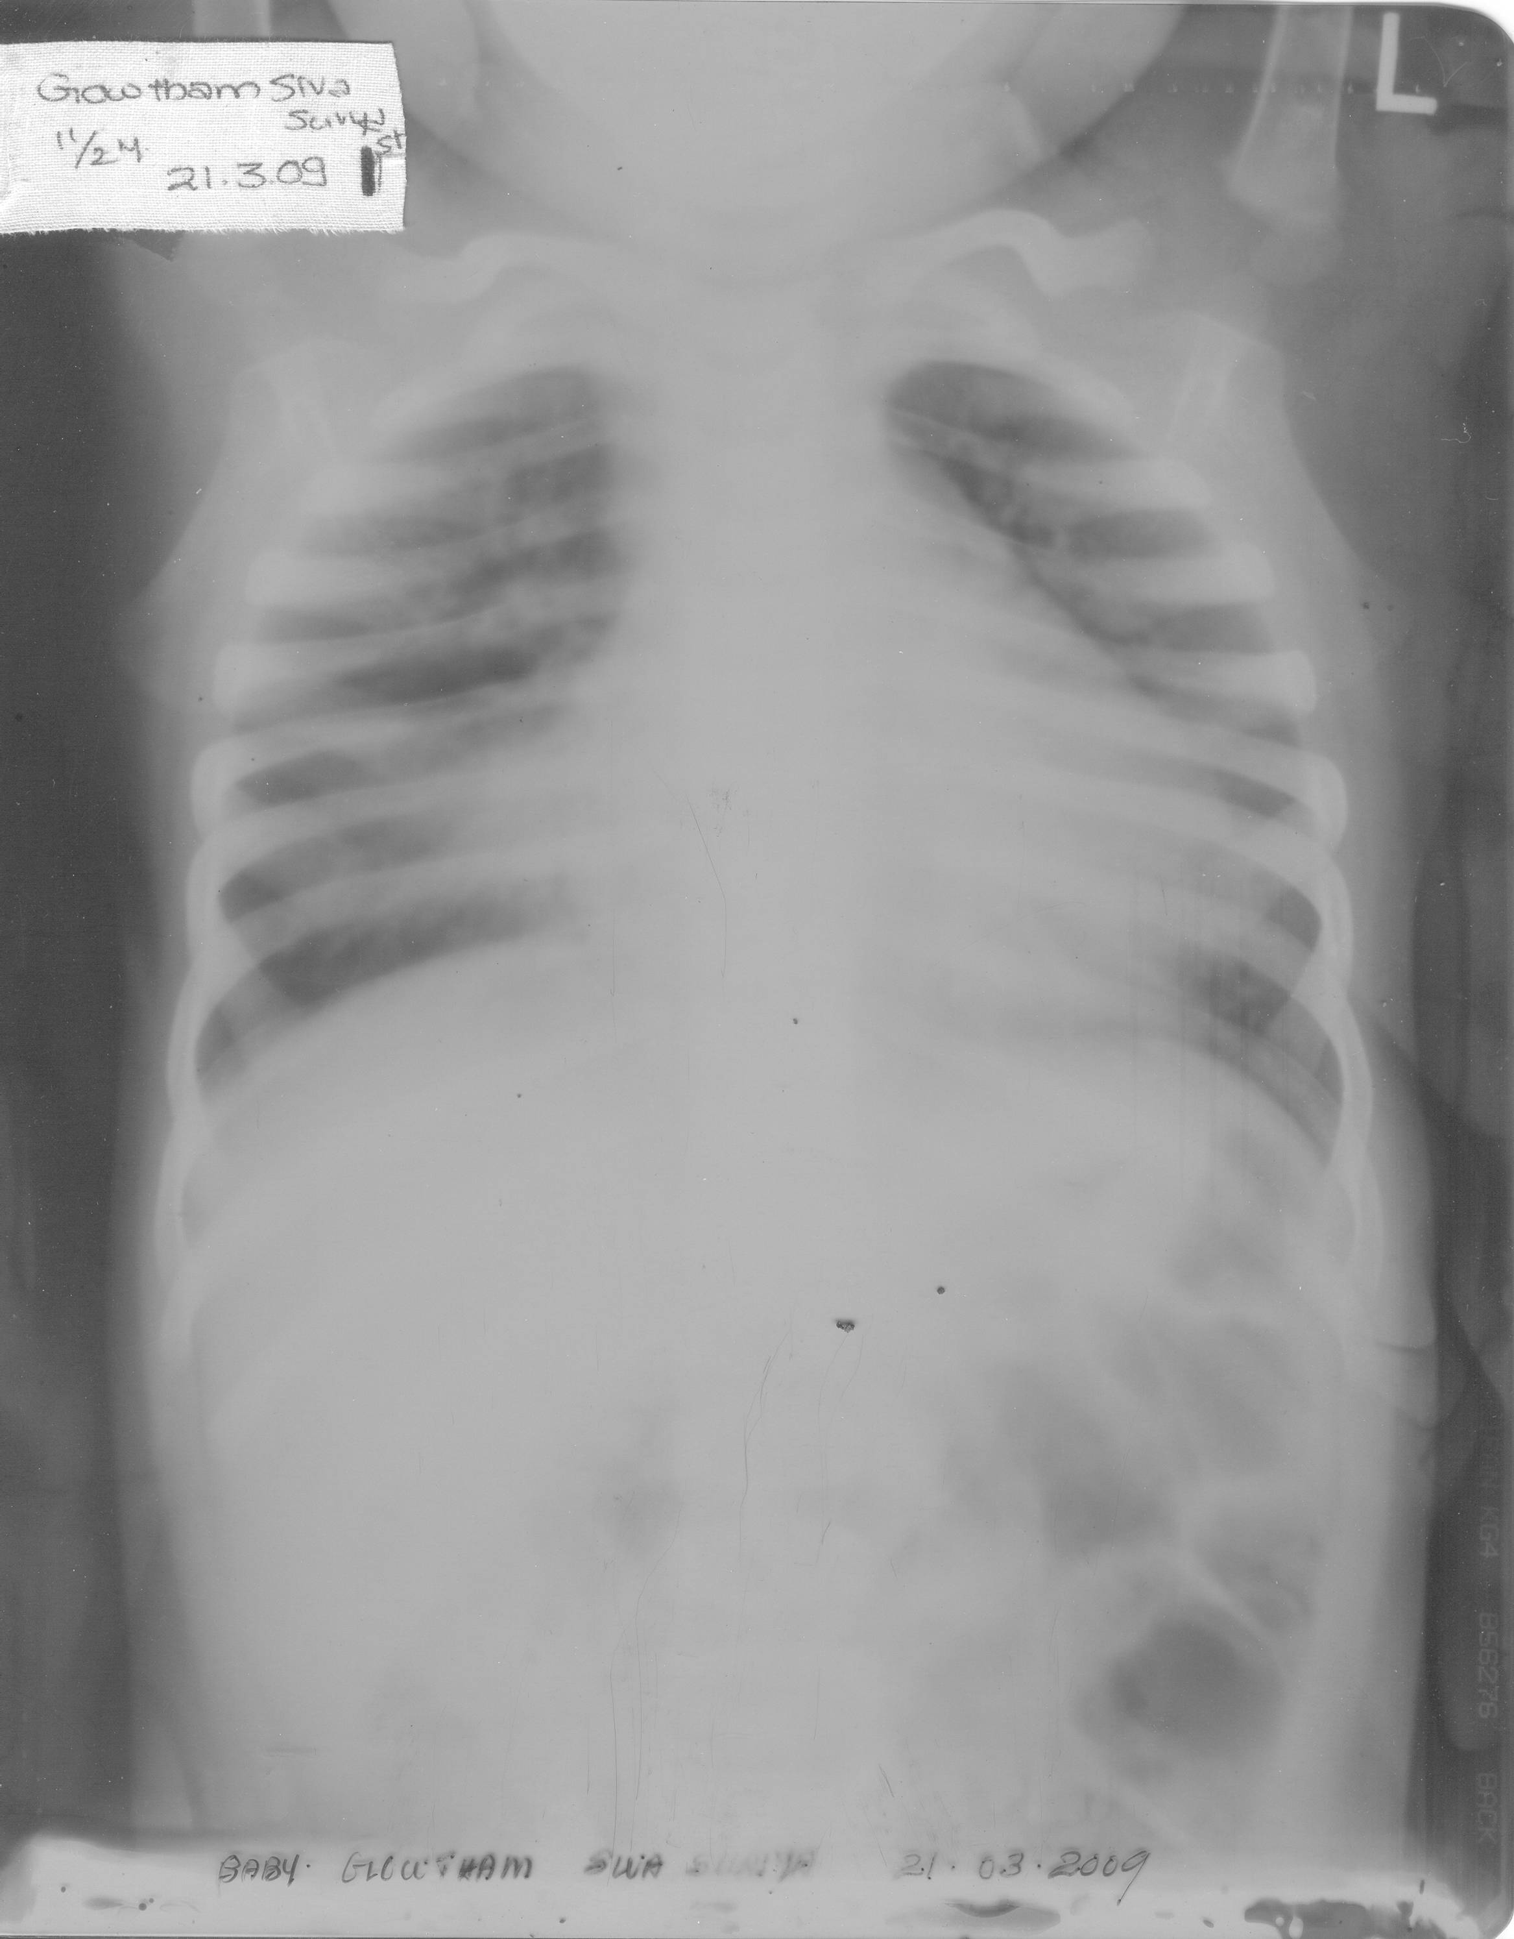

Slide 42
On 22-3-09' complaints slightly better cough and weakness slightly persist. Appetite improved. Rx PLACEBO was prescribed. At 12.30 (midnight) complaints aggravated and Rx ANTITART 200/ 1 dose in 10 ml 10gtt 3 hrly, 3 times was prescribed.

Slide 43
On 23-3-09' cough better, weakness increased generals. good Rx Antitart 200 + 1 / 1 dose in 10 ml 10 gtt (stat), Placebo was prescribed. On 24-03-09' Complaints feels better cough slightly persist, weakness slightly persist vomiting to day white taking milk Appetite improved generals good Rx PLACEBO was prescribed.
On 25-03-09' complaints better, cough better weakness relieved generals good o/e : chest clear Rx PLACEBO was given he was improved and discharged.

Slide 44
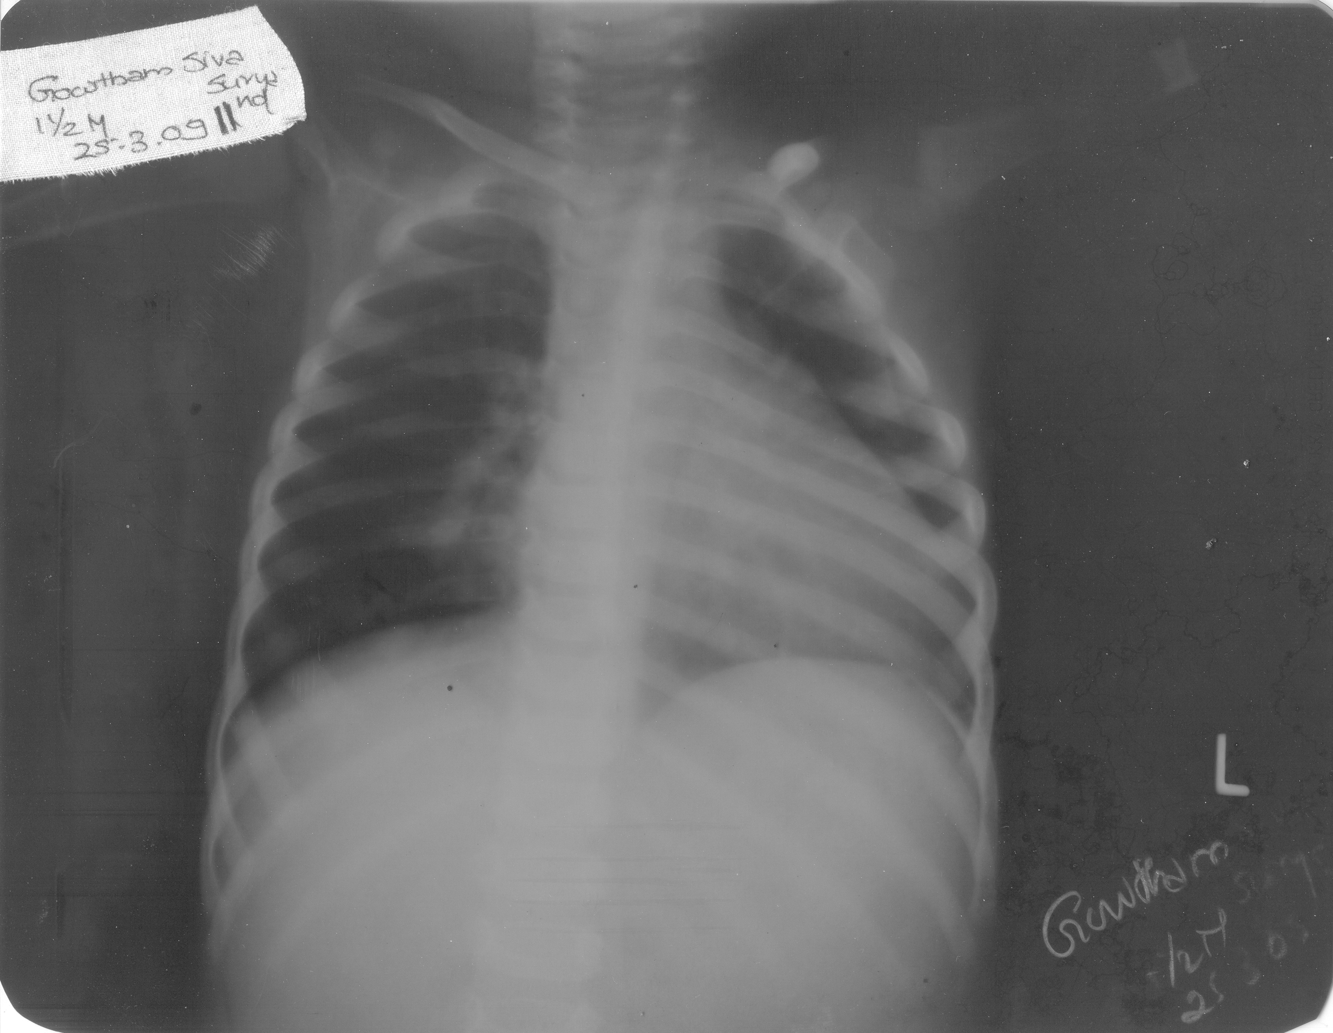

Slide 45
On 28-03-09' complaints better generals : good. PLACEBO was given.
On 31-03-09' cough better weakness better generals good o/E : chest clean, Rx Sac Lac 1 dose was given on 20-04-09' complaints feels better. Rx Placebo was given.
On 23-04-10 cough feels slightly better weakness feels better generals : good o/E : chest clear. Rx PLACEBO was given.
On 18-06-09' cough relieved, weakness relieved App: N generals : good Rx PLACEBO was given PLACEBO was continued for 1 month.

Slide 46
Case iii

Slide 47
DATE:19-03-07
NAME:BIBIN ;
AGE- 3 yrs
SEX - M/C
DISEASE DIAGNOSIS : BRONCHIAL ASTHMA

Slide 48
Case summary
About 6 months after birth he had repeated attacks of breathing difficulty.
His parents gave him allopathic treatment - injections usually.
Temporary relief was there ,but he was not free from R/A of asthma
So they started homoeopathic treatment

Slide 49


Slide 50
His paternal grand mother had H/O asthma & his maternal grandparents had died of Ca.
The child had skin eruptions 3 or 4 months after birth.
Restless active child. Birth wt ,milestones – normal; appetite good , thirst for cold, other generals good

Slide 51
Individual investigation
Desire Cold drinks, egg, sweets ,sour ++ ,fruits but < complaints.
Child normally very active but when sick, Extremely weak & irritable
Lies on knee chest position during
H/O of suppressed Skin complaints
H/O of Ca in the family

Slide 52
Individual & disease symptoms
F/H of cancer, Bronchial Asthma
Intolerance for,milk, egg, fat, meat, sweet’ sour and fruit.
Knee – elbow position in sleep
Irritability : +++
FH/of Bronchial Asthma
Dyspnoea & cough usually at night
Vesicular breathing with prolonged expiration
Wheeze
Carcinosin 1M /1D

Slide 53
Individual Diagnosis
Chronic disease
Disease Diagnosis
Bronchial Asthma

Slide 54
Management
Individual
Avoid food which < complaints-meat,sour, fruits, egg & cold food
Disease
avoiding known allergens and respiratory irritants
Exposure to cigarette smoke, air pollution, industrial dusts, and irritating fumes should also be avoided.
Avoid playing with pet animals
Rooms should be cleaned or vacuumed regularly & kept free from dust
Avoid emotional excitement

Slide 55
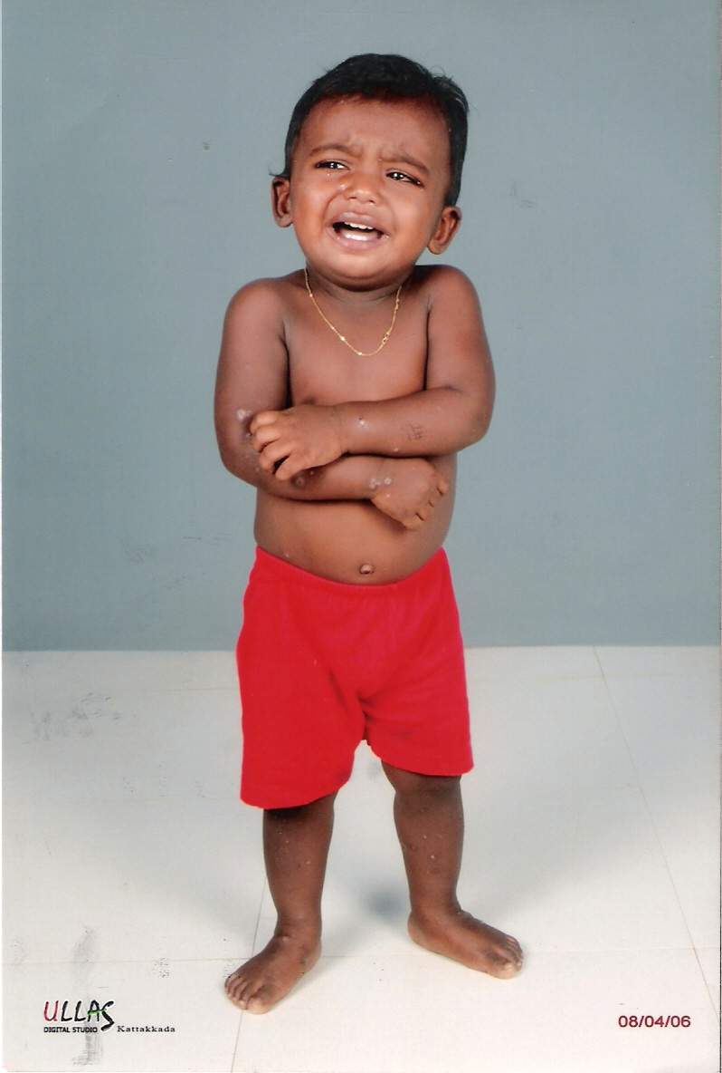
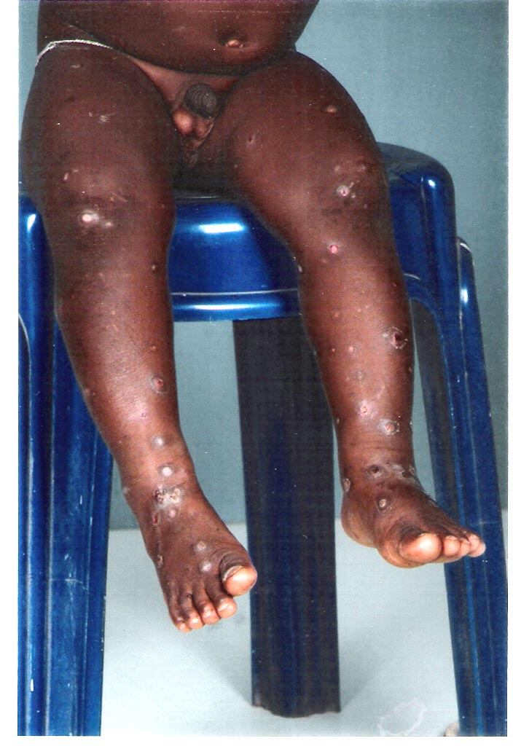
After taking the Carcinosin his old skin complaints came out
.
Skin eruptions after carcinosin

Slide 56

Individual symptom change
He is free from his
Asthma for the last one yr
Position in sleep normal
Can eat fruits, sour ,cold etc no complaints

Slide 59
Case 4
Op no: 21/9 . Date : 10- 2 – 2009
Name :xxx . Age /sex :29/F
P/C : Breathing difficulty < since yesterday night
< while lying down and
>ameliorated while sitting up with head low and rocking.
She had not slept last night.

Slide 60
On examining the chest rhonchi was heard in all lung fields .
Depending on acute modality, Moschus 200 was prescribed along with oxygen therapy.
But complaints still persisted and so, restudy of case was done .

Slide 61
Following symptoms were collected from the patient –
Burning in interscapular region during breathing difficulty
Over sensitive to noise
Amelioration from rocking
Amidst the severity of complaints the patient was so co-operative in case taking.
Breathing difficulty aggravation during full moon
Fearful even to family members.

Slide 62
Based on these symptoms Phosphorus 0/3-1 dose was given and follow-ups followed thereafter .
Next day the frequency of breathing difficulty was reduced and rhonchi was heard only on the left lobe of lungs

